Slide 1
Reduce Escalations,
Improve CSAT &
Increase Productivity

Slide 2
What is the purpose of this document?
Who is this for?
Outline a standard process for a customer to achieve results with SupportLogic during the first 3 - 6 months after go live is completed or to refresh adoption
Set Expectations with Customers on what is needed to ensure the success of the program
Primary Users - Support Managers, Escalation Managers, and Swarm Leads
Leadership

Slide 3
Agenda
SupportLogic Success Plan
The 4 step Workflow
Resources

Slide 4
Success Plan for Support Leaders

Slide 5
Success Plan
Achieving results in SupportLogic’s SX Platform is contingent on performing a prescribed workflow in the application on a daily basis
Workflows are performed by Support Managers, Escalation Managers, and/or Swarm Leads depending on the structure of your teams
Achievement is contingent on Accountability
*Assumes business as usual and we must account for seasonal variation in your escalation rates

Slide 6
What results should we expect?
Escalation Rate reduction of 20 - 50% over 3 month period*
Improved overall CSAT scores and reduced variance of CSAT
Productivity gains of up to an hour per day for each support manager
Why these results?
These are what other customers have achieved by following the 4 step prescribed workflow
*Assumes business as usual and we must account for seasonal variation in your escalation rates

Slide 7
The 4 step prescribed Workflow
Notes:
Customer Health?

Slide 8
SupportLogic Core Concepts
The videos below are designed to acquaint you with how the machine learning engine works in SupportLogic and highlight the advantages our Sentiment and Attention detection provides.
Invest just 15 minutes of your time to understand the core concepts in SupportLogic so you can be productive immediately.
Initial Viewing - Review the 5 videos on our Help Center
https://supportlogic.freshdesk.com/support/solutions/articles/73000564923-supportlogic-onboarding-core-concepts

Slide 9
The 4 step prescribed Workflow
Notes:
Customer Health?

Slide 10
The prescribed workflow
Take action on all cases in the console that contain inbound Needs Attention and Negative signals
Take action on all Escalation Predictions, Escalations Requests, and Active Escalations
Take action on Alerts so that you can stay up to date throughout the day
Take action on backlog based on the list views in SupportLogic (time permitting)
Time commitment is 20 minutes twice per day plus engaging on alerts as they are received
*Prerequisite - Must have created global filter for your team to use in the prescribed workflow

Slide 11
What do we mean by Take Action?
Support Organizations have standard operating procedures for handling troubled cases such as but not limited to the following
Respond to the customer
Add an internal case note with relevant instructions for the case owner
Escalate the case to next Tier (if you are on a tiered model)
Initiate a swarm on the case with relevant subject matter experts
Engage the CSM or AM if needed to get ahead of a potential escalation
SupportLogic is an early warning system and should act as a force multiplier for your existing processes

Slide 12
Step 1
Take action on all cases in the console that contain inbound Needs Attention and Negative signals
Why Needs Attention and Negative Signals?
These signals represent the voice of the customer expressing a perception that their issues or concerns are not being addressed
What should I do with these cases?
Take steps to prioritize the cases as needed to drive an improved outcome for the customer
*Must acknowledge Sentiment Signals on the cases for accountability

Slide 13
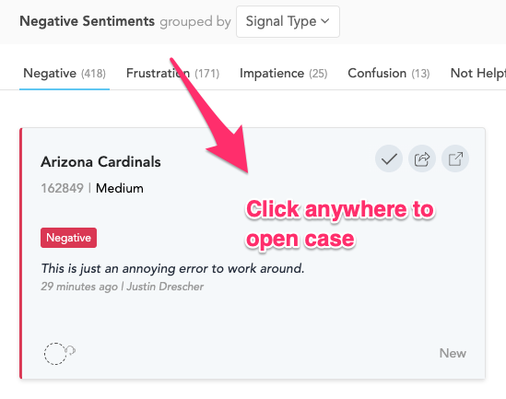
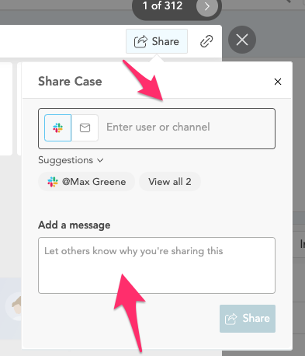
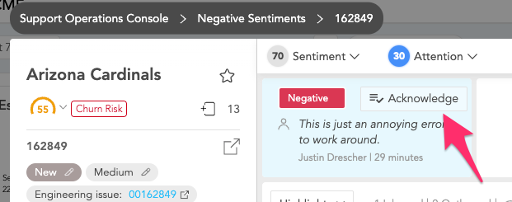
Review Case - Console
Open case from Console
Review and share case
Acknowledge Sentiment for accountability
*More details on the Console can be found here

Slide 14
Step 2
Take action on all Escalation Predictions, Escalations Requests, and Active Escalations
Why Escalation Predictions and Escalation Requests?
Escalation Predictions are cases that are at risk due to similarities to other escalations from your past.
Escalation Requests are cases where the customer has specifically asked for an escalation.
What should I do with these cases?
Take steps to prioritize the cases as needed to drive an improved outcome for the customer
*Must acknowledge, snooze, or dismiss predictions for accountability

Slide 15
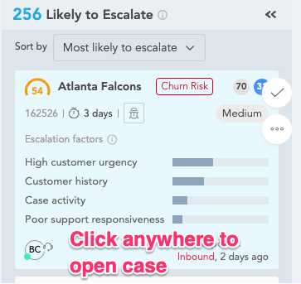
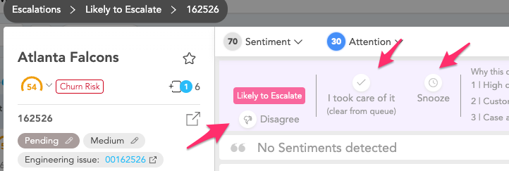
Review Case - Escalations
Open case from Escalations page
Review and share case as needed
Acknowledge Snooze or Dismiss for accountability
*More details on Escalations can be found here

Slide 16
Step 3
Take action on alerts to stay up to date throughout your day
What alerts should I configure?
Alert me when a negative or needs attention signal is detect on an inbound comment for any case that falls under my purview
What should I do with these cases?
Take steps to prioritize the cases as needed to drive an improved outcome for the customer

Slide 17
Among All the Alerts…
What do successful customers focus most on?
Follow-up
Frustrated
Negative
Confusion
Lack of Progress
Churn Risk
Likely to Escalate
Call Request

Slide 18
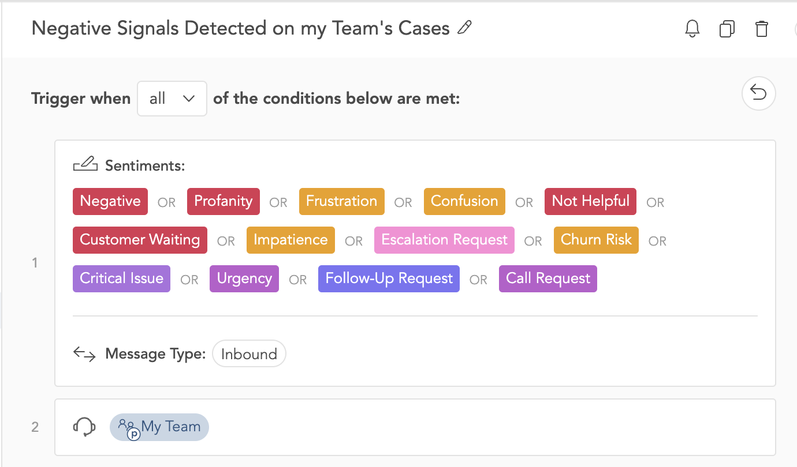
Alert #1 - Configuration
Go to My Alerts
Select + New Alert
Add all Negative and Needs Attention Signals
Add Message Type - Inbound
Add your Virtual Team or other relevant filter
*Detailed instructions on creating alerts can be found here

Slide 19
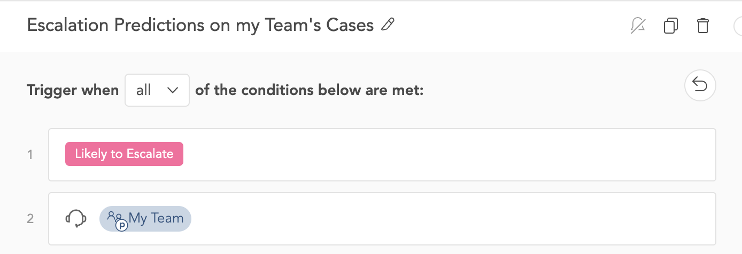
Alert # 2 - Configuration
Go to My Alerts
Select + New Alert
Add Likely to Escalate
Add your Virtual Team or other relevant filter
*Detailed instructions on creating alerts can be found here

Slide 20
Step 4
Take action on backlog based on the list views in SupportLogic (time permitting)
Which list views should I use?
We recommend starting with cases sorted by the lowest Sentiment Scores and highest Needs Attention Score
After that you can move on to cases pending reply from your team and aging cases
What should I do with these cases?
Take steps to prioritize the cases as needed to drive an improved outcome for the customer

Slide 21
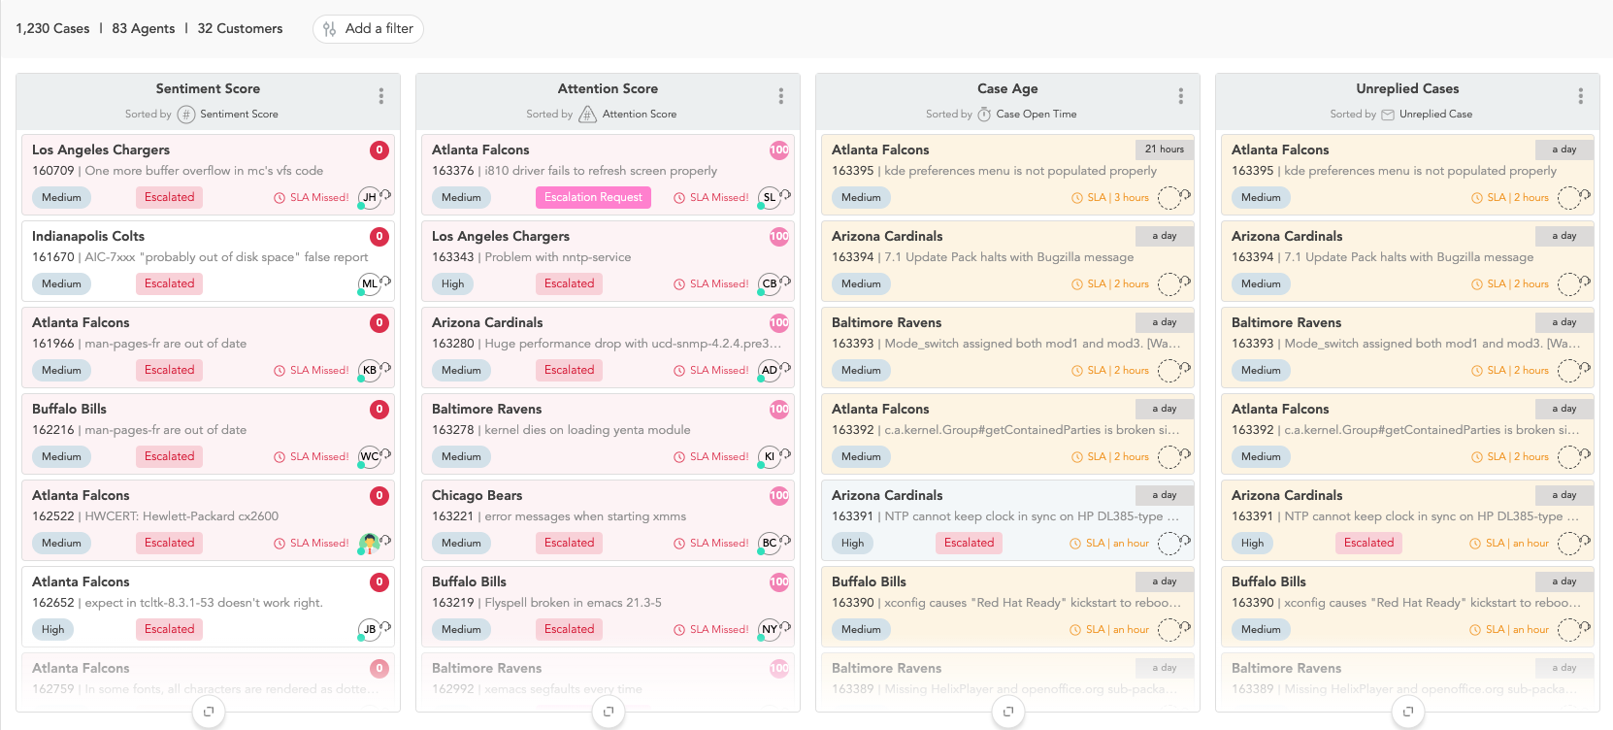
Review Backlog
Open Backlog Page
Configure Recommended Lists
Review Cases and take action as needed
*More details on configuring Backlog Lists can be found here

Slide 22
How much time will this take?
Time commitment is 20 minutes twice per day plus addressing alerts that you receive
When should I perform the workflows?
The workflow should be performed at the start of your day to achieve the best results.
It should be performed a second time in the middle of your shift to review any new signals and backlog.
How can 20 minutes twice a day be enough time?
SupportLogic prioritizes cases for you based on risk factors so you don’t have to read them all
Notes:
SupportLogic reads all your cases so that you don’t have to

Slide 23
Common Questions
Why is it important to acknowledge and action signals or escalation predictions?
Accountability. “I am aware of this case and I am responsible for its outcome”
Why only 20-40 minutes a day?
This is approximately the amount of time needed to review the cases highlighted in SupportLogic. Additional work may be needed to drive an improved outcome on the case.
Are there any additional results I may achieve via these steps?
Being proactive on cases based on Signals can also prevent churn among your customers

Slide 24
Resources
Notes:
CSAT?
NPS? Improved MTTR?
Escalation Rate?
Customer Health?

Slide 25
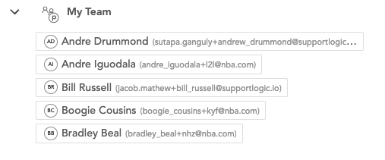
Create your Virtual Team
Go to Virtual Teams
Select Create Virtual Teams
Name your Team
Add your Agents
Save your Team
*Detailed instructions on creating virtual teams can be found here

Slide 26
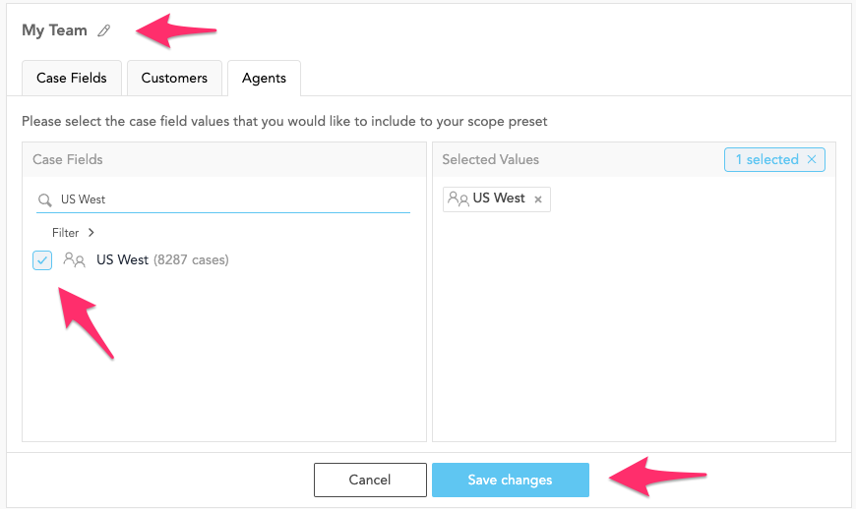
Create your Global Filter
Name your Filter
Select your Team
Save the Filter
*You may create global filters using fields as well depending on your needs
*Detailed instructions on creating global filters can be found here

Slide 27
Resources
Support Manager Workflow Instructions - Step by Step guide for SupportManagers
Support Manager Workflow Video - Video Guide for Support Managers
Alerts Configuration Instructions - Key Alerts to Configure
Global Filter Configuration - Configuring the Global Filter to view your Cases
SupportLogic Help Center - General SupportLogic Resources

Slide 28
Thank you!

